Slide 1
Standard Deviation: Using Technology
Year 11 Essentials

Slide 2
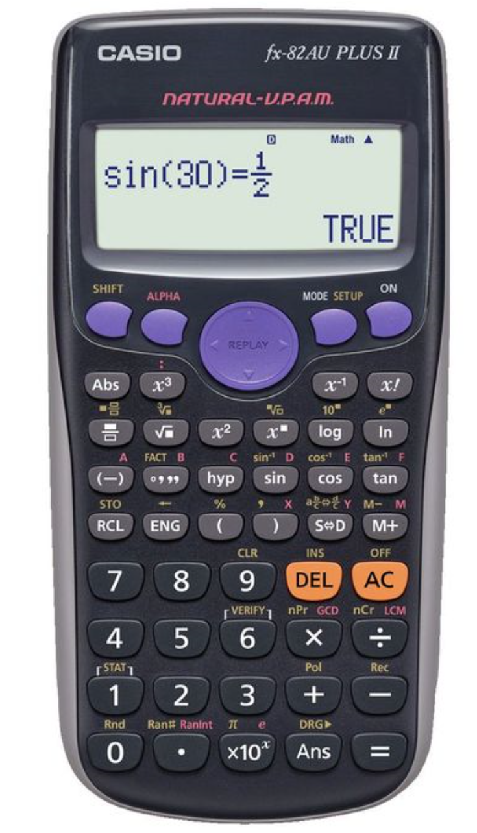
You Will Need a Scientific CalculAtor CASIO fx-82AU PLUS II

Slide 3

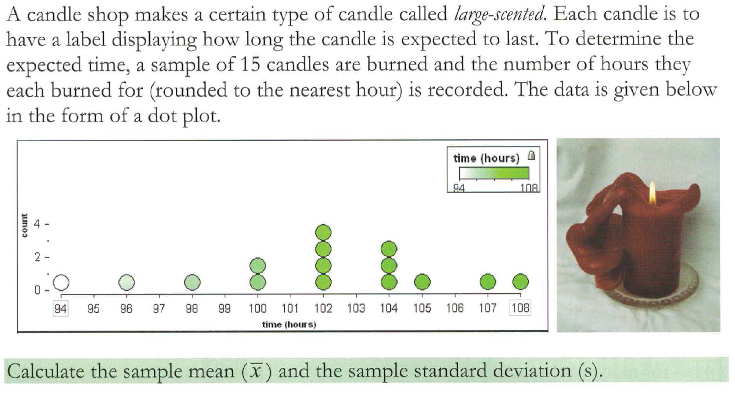
Example

Slide 4
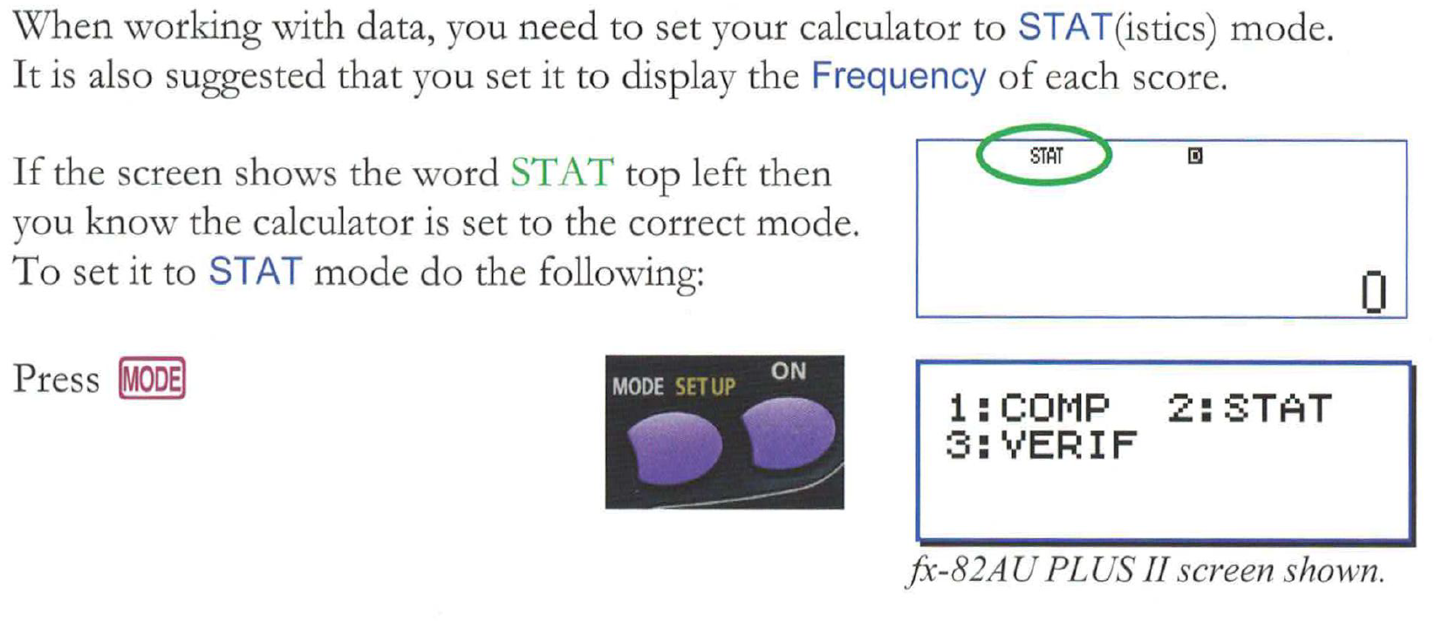
Step 1
Choose the STAT mode on your calculator

Slide 5
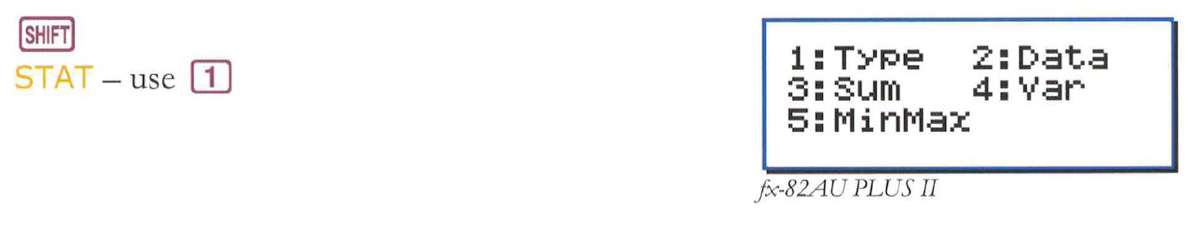
Step 2
Choose option 1 to set the type of data

Slide 6
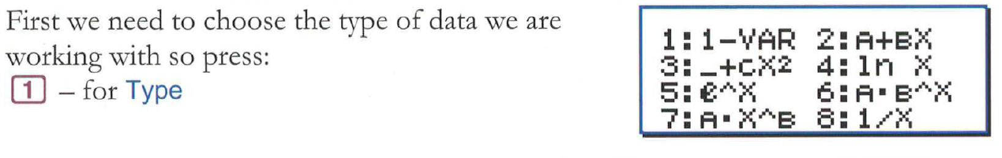
Step 3
Choose Option 1 for 1-VAR

Slide 7
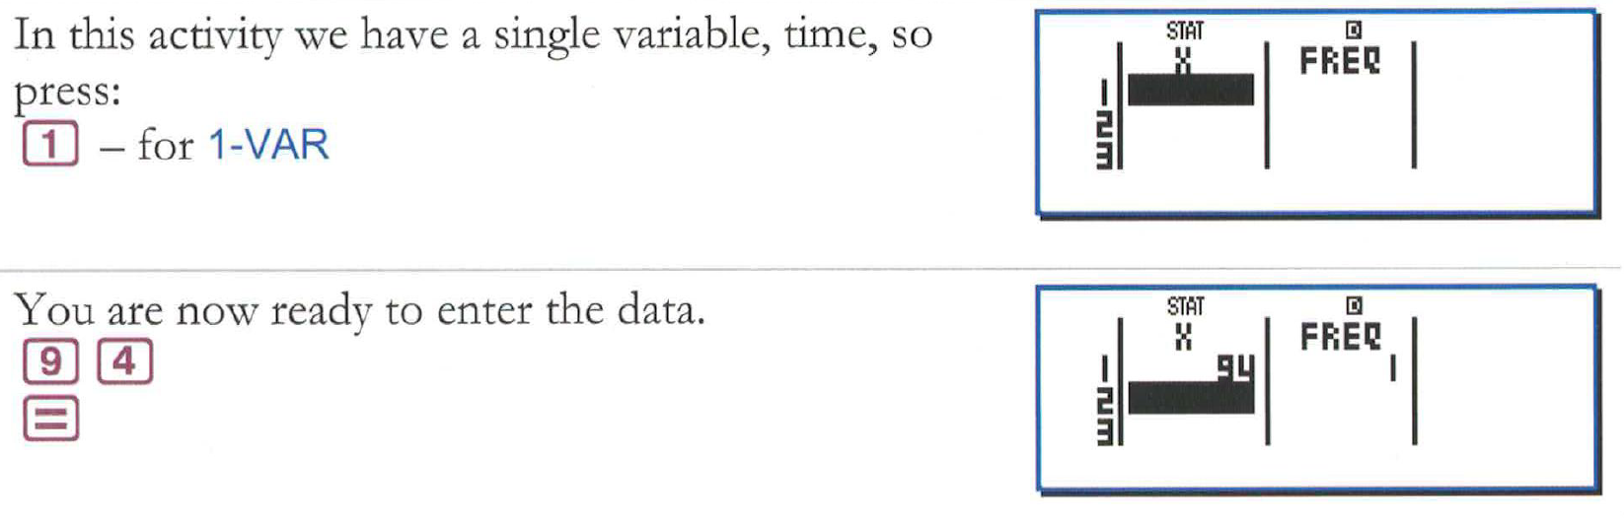
Step 4
Enter the data into the frequency table

Slide 8
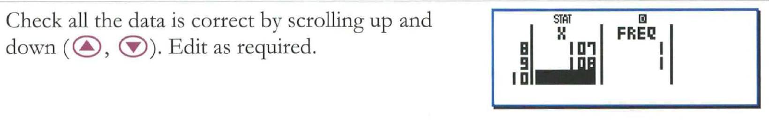
TIP!
TIP: You can scroll up and down the frequency table to check your entries. Edit as needed.

Slide 9
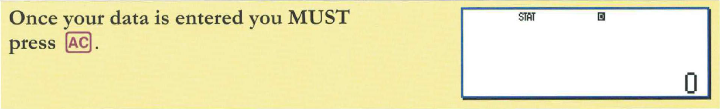
Step 5
Once your data is entered, press the AC button

Slide 10
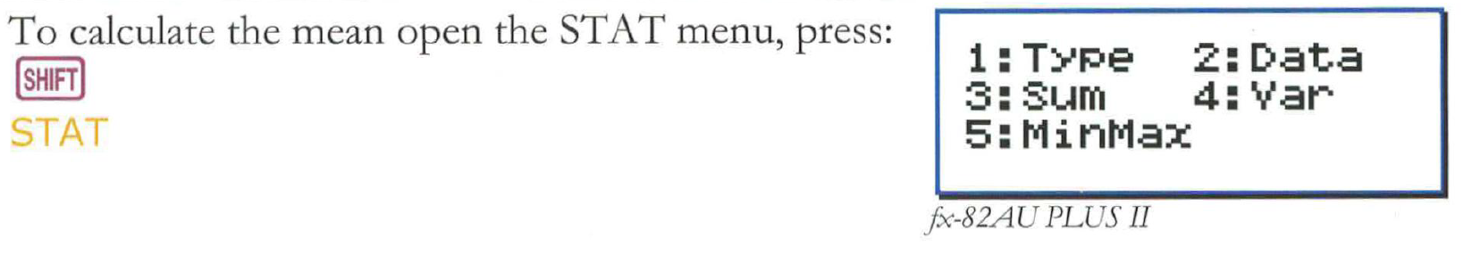
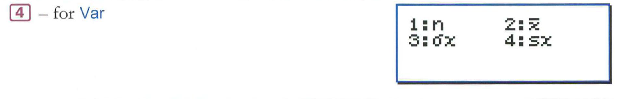
Step 6
Open the STAT menu once again
Choose Option 4:VAR

Slide 11
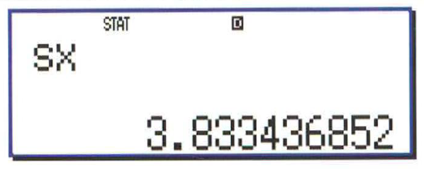
Step 7
Choose Option 4 to get the value for standard deviation and press the = button
The standard deviation should appear like this

Slide 12
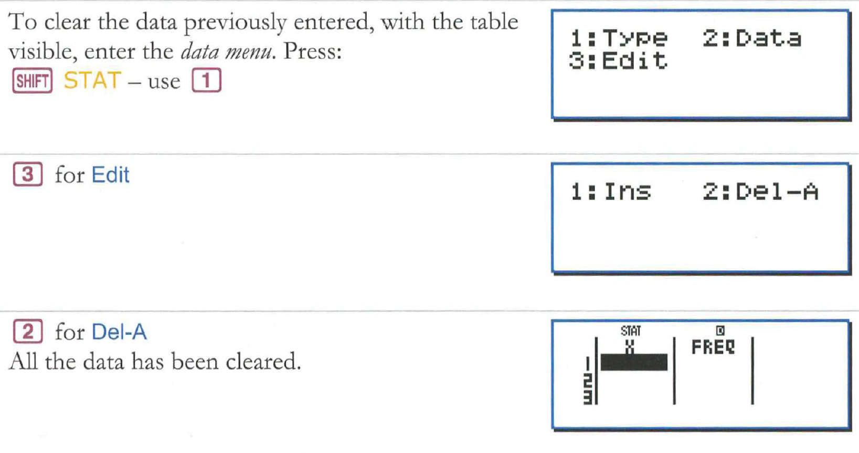
TIP!
TIP: Remember to clear the data entered in the frequency table before entering new data.

